Slide 1
The microbiome and mental health
Dr Kate Lawrence
St Mary’s University, Twickenham

Slide 2
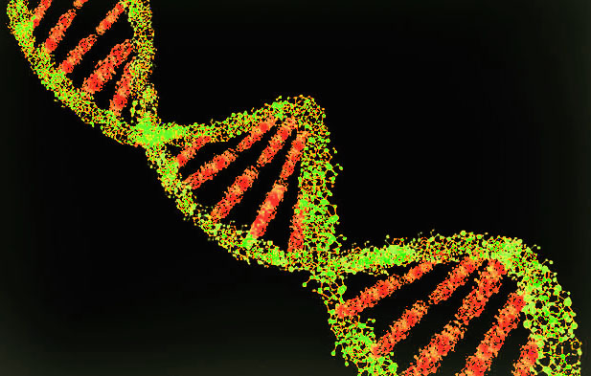
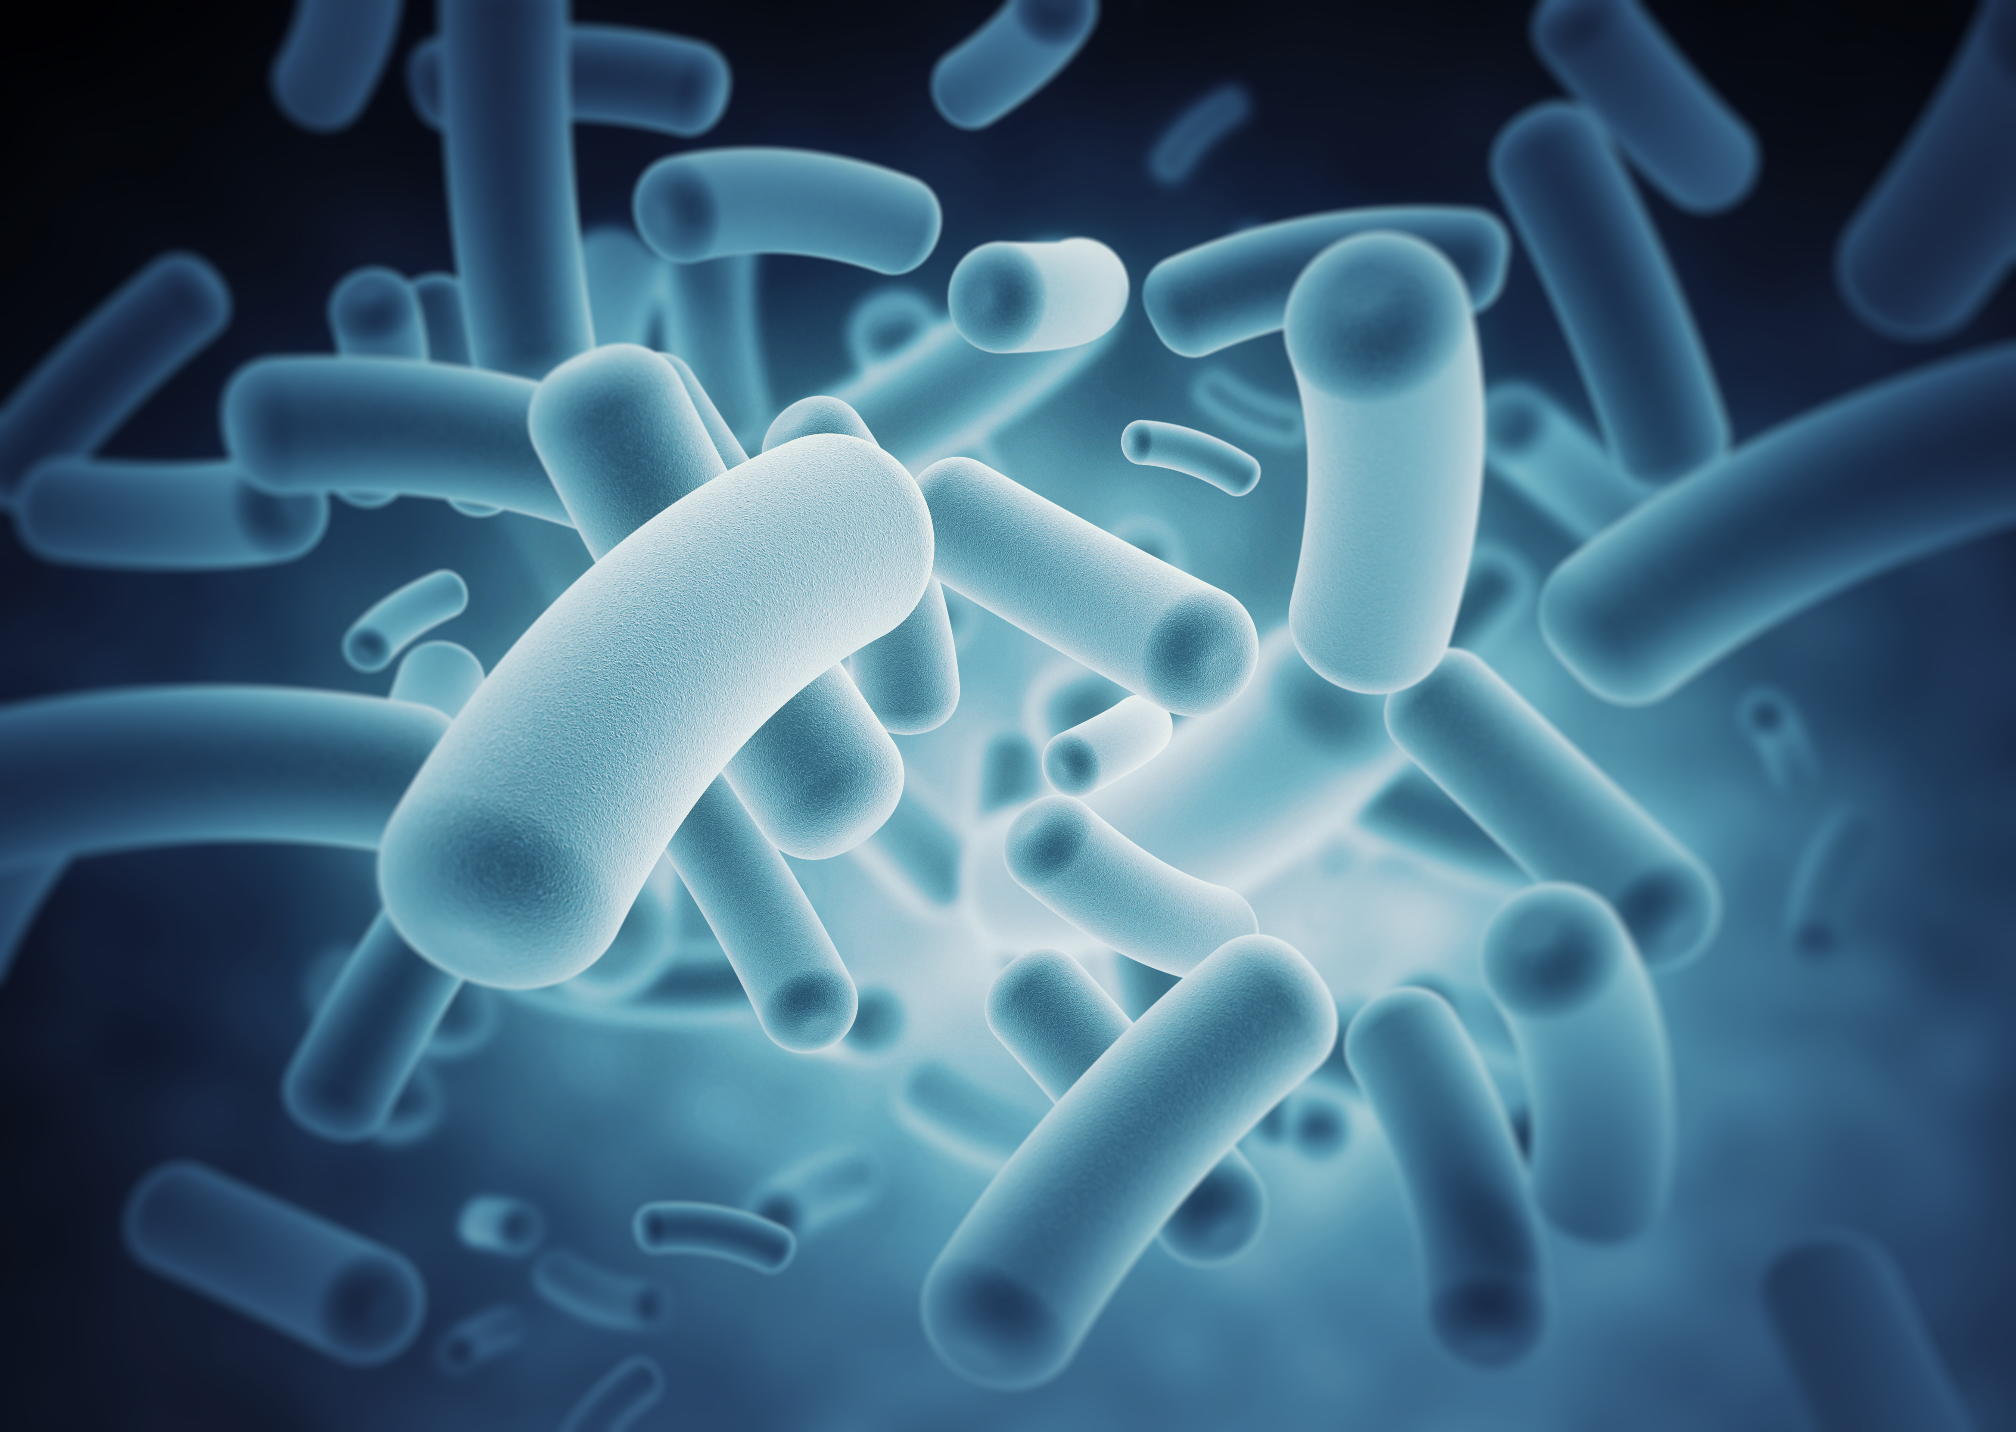
The new genetic revolution?
20th Century
Human genome
21st Century
Human microbiome

Slide 3
Pathways between the brain and the gut
BRAIN
Stress
Anxiety
mechanism
Cortisol/adrenalin etc.
??????
GUT
Gastrointestinal symptoms
IBS

Slide 4
Pathways between the brain and the gut
BRAIN
Schizophrenia
Depression/anxiety
mechanism
???
???
GUT
Coeliac disease
IBS

Slide 5
Microbiome
Hormones, neurotransmitters, vitamins, immune system
Inflammation
Stress/anxiety mental-health
Production of cortisol, adrenalin etc.
Gastrointestinal symptoms

Slide 6
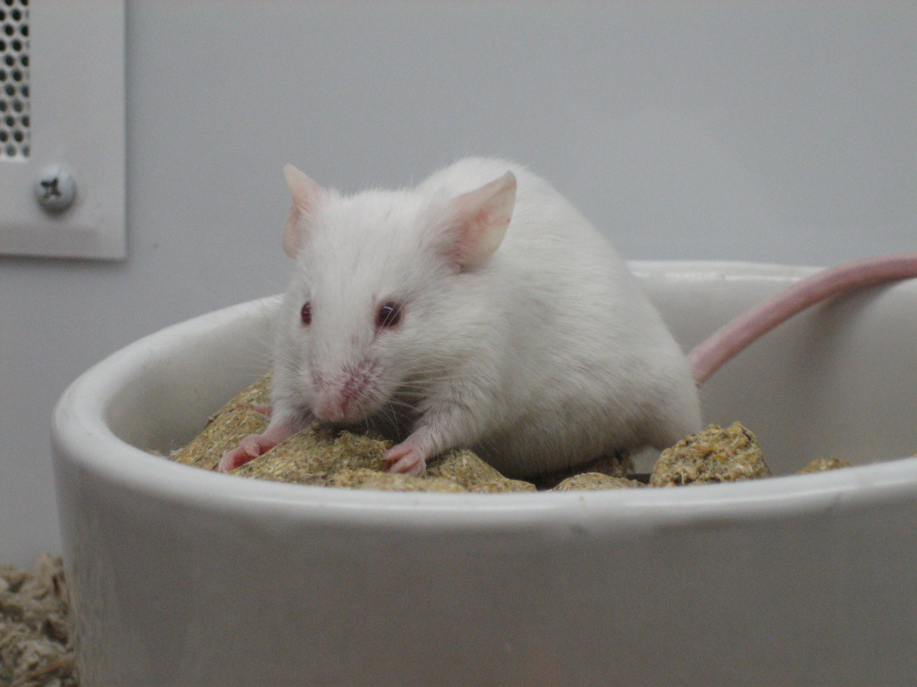
Animal Research
Germ-free mice
Reduced stress response
Neufeld KM, Kang N, Bienenstock J, Foster JA. Reduced anxiety-like behavior and central neurochemical change in germ-free mice. Neurogastroenterol Motil 2011 Mar;23(3):255–64, e119. pmid:21054680
Anxiety behaviour
BNDF

Slide 7
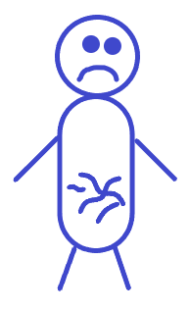
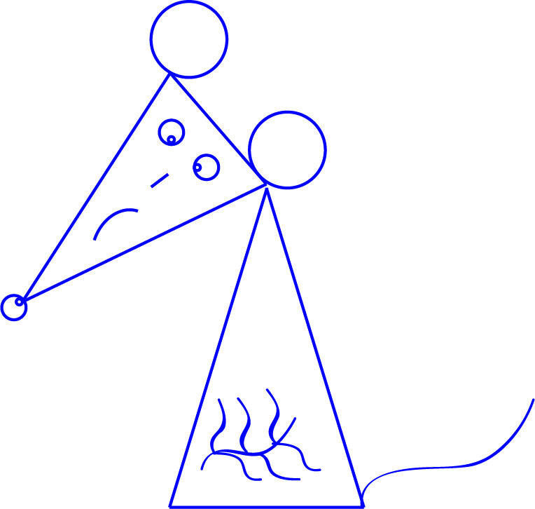
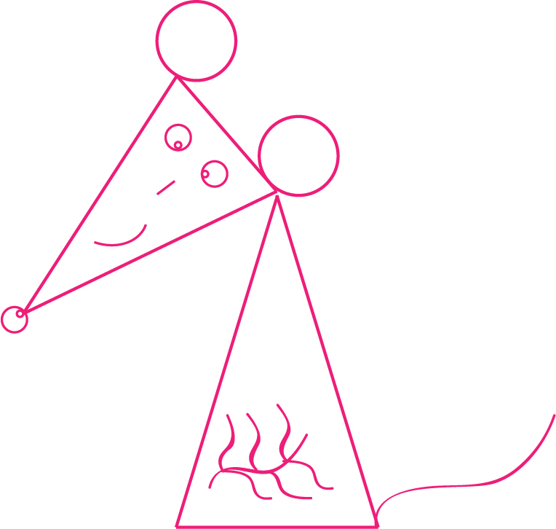
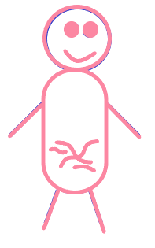
Can depression be transmitted?
Kelly, J. R., Borre, Y., O'Brien, C., Patterson, E., El Aidy, S., Deane, J., Kennedy, P. J., Beers, S., Scott, K., Moloney, G., Hoban, A. E., Scott, L., Fitzgerald, P., Ross, P., Stanton, C., Clarke, G., Cryan, J. F., Dinan, T. G. (2016). Transferring the blues: Depression-associated gut microbiota induces neurobehavioural changes in the rat. Journal of Psychiatric Research, 82, 109-118. 10.1016/j.jpsychires.2016.07.019 [doi]

Slide 8
The ‘SMILES’ trial
12 week RCT
Nutrition advice (n=33) ModiMedDiet
parallel group – social support (n=34)
Self-reported depression symptoms
Remission achieved for 30% of diet group, 10% of control group
Jacka, F.N.; O’Neil, A.; Opie, R.; Itsiopoulos, C.; Cotton, S.; Mohebbi, M.; Castle, D.; Dash, S.; Mihalopoulos, C.; Chatterton, M.L. A randomised controlled trial of dietary improvement for adults with major depression (the ‘SMILES’ trial). BMC Med. 2017, 15, 23. 10.1186/s12916-017-0791-y [doi]

Slide 9
Influence of fermented probiotic drink on brain activity
Healthy women
Fermented probiotic drink
4 weeks
task
Viewing negative emotions
fMRI
Decreased activity in regions processing sensation & emotion
Tillisch, K., Labus, J., Kilpatrick, L., Jiang, Z., Stains, J., Ebrat, B., Guvonnet, D., Legrain-Raspaud, S., Trotin, B., Naliboff, B., Mayer, E. A. (2013). Consumption of fermented milk product with probiotic modulates brain activity. Gastroenterology, 144(7), 1394-401. 10.1053/j.gastro.2013.02.043 [doi]

Slide 10
Probiotics & anxiety
Rao et al (2009) | Chronic Fatigue syndrome 39 patients –probiotic L. casei vs placebo 2 months Significant decrease in anxiety Yakult-funded
Kato-Kataoka et al (2016) | 47 medical students preparing for exams L. casei vs placebo 8 weeks Lower levels of cortisol and anxiety Yakult-funded

Slide 11
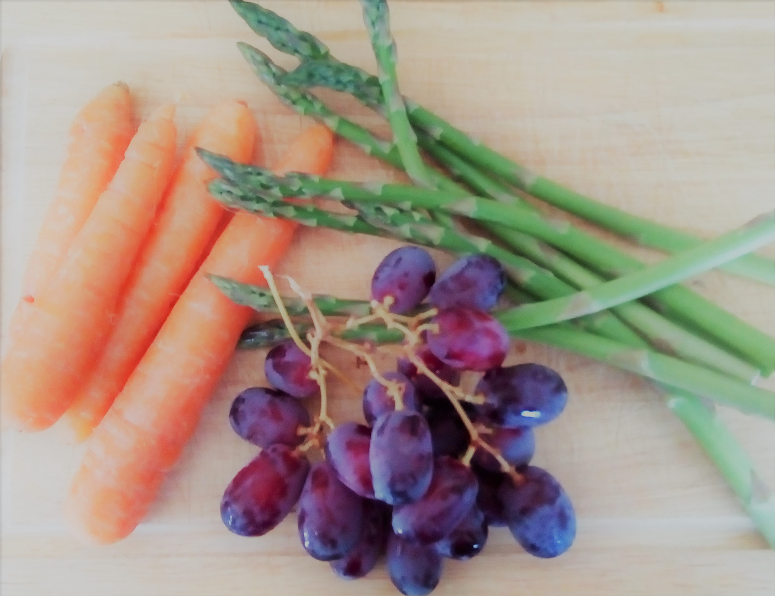
Preliminary work with nutritional therapist Jeannette Hyde
Diet similar to the ModiMedDiet plus:
Prebiotic fibre
No grains
Fermented food
Time-restricted feeding
weight mood
gastrointestinal symptoms cognitive function

Slide 12
ADHD –dietary approaches
Exclusion of artificial food colourings
EFA supplemen-tation
Food intolerance exclusions
Few foods diet
Mechanism
unknown???

Slide 13
Potential mechanism?
Microbiome
Exclusion of artificial food colourings
EFA supplementation
Food intolerance exclusions
Few foods diet

Slide 14
Dietary principles - 4 week study. Each day…
1. Eat at least seven portions of different varieties of vegetables & fruit
2. Have a 12 hour overnight break from food
3. Drink a Kefir drink
4. Eat a microbiome friendly, protein rich breakfast
5. Exclude sugar and artificial sweeteners

Slide 15
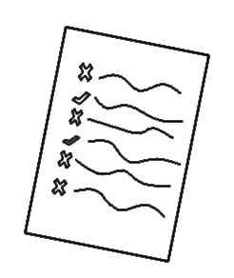
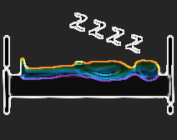
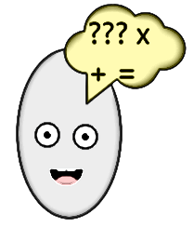
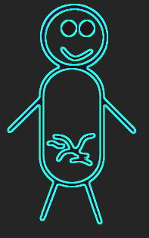
Outcome measures…
ADHD symptoms (questionnaire)
Sleep (actigraph recordings)
Cognitive function
Gut microbiota

Slide 16
Ways to manipulate the gut microbiome…
Diet
Probiotics
Exercise
Faecal transplants
Helminthic therapy

Slide 17
Key references
Foster, J. A., Rinaman, L., Cryan, J. F. (2017). Stress & the gut-brain axis: Regulation by the microbiome. Neurobiol Stress, 19:7, 124-136. 10.1016/j.ynstr.2017.03.001 [doi]
Kelly, J. R., Borre, Y., O'Brien, C., Patterson, E., El Aidy, S., Deane, J., Kennedy, P. J., Beers, S., Scott, K., Moloney, G., Hoban, A. E., Scott, L., Fitzgerald, P., Ross, P., Stanton, C., Clarke, G., Cryan, J. F., Dinan, T. G. (2016). Transferring the blues: Depression-associated gut microbiota induces neurobehavioural changes in the rat. Journal of Psychiatric Research, 82, 109-118. 10.1016/j.jpsychires.2016.07.019 [doi]
Tillisch, K., Labus, J., Kilpatrick, L., Jiang, Z., Stains, J., Ebrat, B., Guvonnet, D., Legrain-Raspaud, S., Trotin, B., Naliboff, B., Mayer, E. A. (2013). Consumption of fermented milk product with probiotic modulates brain activity. Gastroenterology, 144(7), 1394-401. 10.1053/j.gastro.2013.02.043 [doi]
Jacka, F.N.; O’Neil, A.; Opie, R.; Itsiopoulos, C.; Cotton, S.; Mohebbi, M.; Castle, D.; Dash, S.; Mihalopoulos, C.; Chatterton, M.L. A randomised controlled trial of dietary improvement for adults with major depression (the ‘SMILES’ trial). BMC Med. 2017, 15, 23. 10.1186/s12916-017-0791-y [doi]

