Slide 1
Greater efficacy for CMJ Jump Height than Flight time: contraction time ratio measures for signaling Neuromuscular fatigue in U-18 EPL academy football players.
Dr Matt Springham
ECSS Conference, Glasgow, 2024

Slide 2
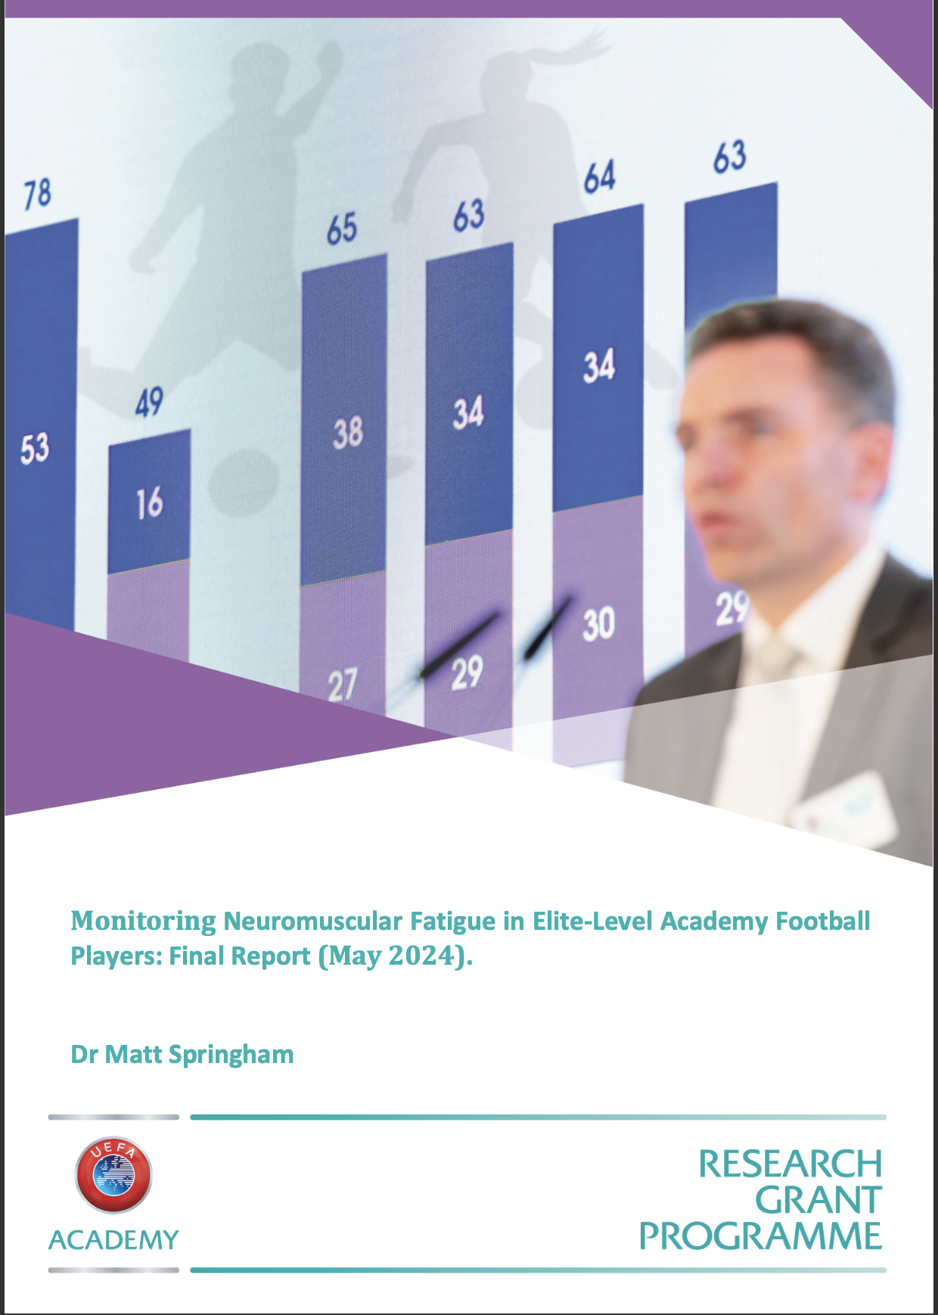
Acknowledgments
Jones, I ^{1, 2}
May, D ³
Norton-Sherwood, C ¹
Salter, J ⁴
Sharma, S. T ¹
Shaw, J. W ²
Singh, N ¹
Stewart, P ¹
Strudwick, A. J ⁵
¹ Arsenal Football Club, UK
² St Marys University, Twickenham, UK
³ Brighton and Hove Albion Football Club, UK
⁴ York St. John University, York, UK
⁵ West Bromwich Albion Football Club, UK

Slide 3
introduction
Match Demands for EPL U-18 = similar to EPL U-21 and First Team
i.e., Reynolds et al (2021) ¹:
10,259 m TD
2,043 m HML
110 m SD
Induces Neuromuscular Fatigue (NMF) = temporary reduction to the maximal force generating capacity of muscle.
↑ Injury Risk and ↓ Physical Performance? ².
Fatigue implicated in 64%, 49% and 27% of hamstring, adductor and quadricep injuries in U-18 EPL players ^{3.}
Countermovement Jump (CMJ) measures commonly used to signal NMF in athletes.
Change to neuromuscular status is used to adjust planned training volume and intensity.
Topical scientific debate: ‘best’ accessible measures of NMF?

Slide 4
Rationale: Existing research
Senior Professional AFL Players:
Cormack et al (2008) ⁴: substantial 24-h ↓ CMJ FT:CT post-match. No change to CMJ JH.
Conclusion: NMF manifests as a change to movement strategy (FT:CT) as opposed to a change to jump performance (JH).
CMJ FT:CT widely adopted as NMF monitoring measure in practice.
Academy Players: limited acute responses research:
Small to Moderate 48-h ↓ CMJ JH ^{5, 6}, maximal velocity ⁵ and reactive strength index ⁶ following U-18 match play ⁵ and strenuous training ⁶ using linear encoder ⁵ and optical timing ⁶ systems.
Efficacy of FT:CT for signalling match induced NMF unknown in academy football players despite widespread use.

Slide 5
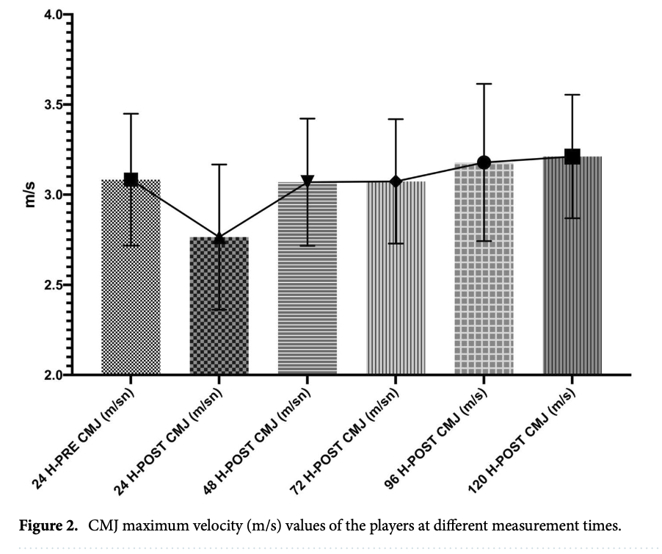
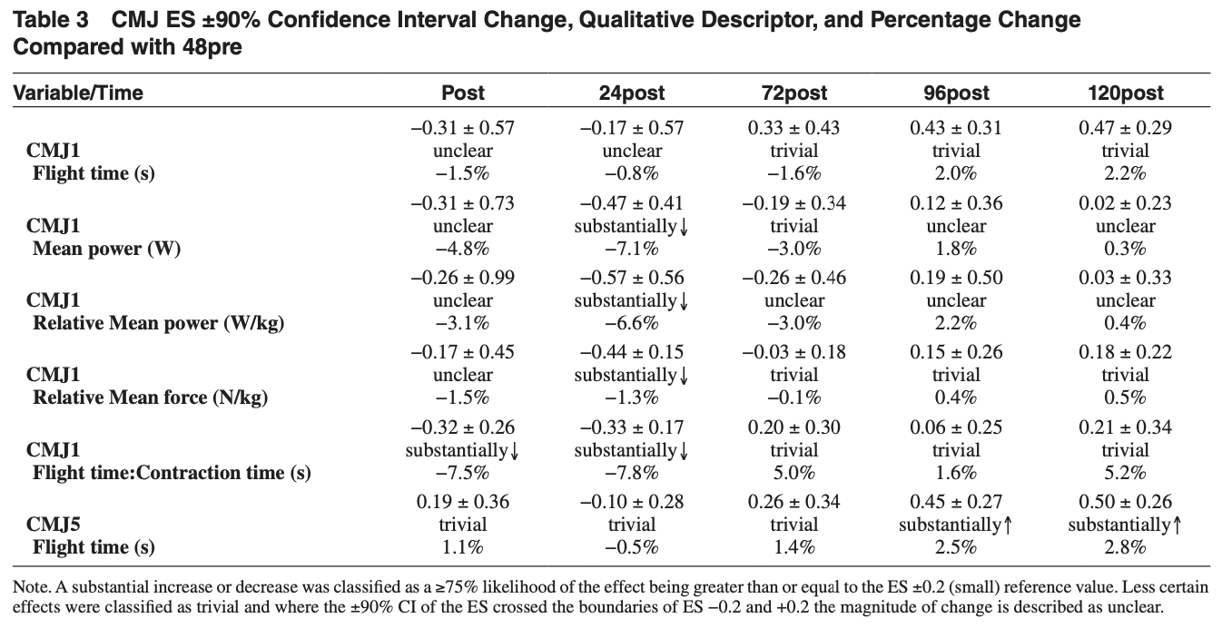
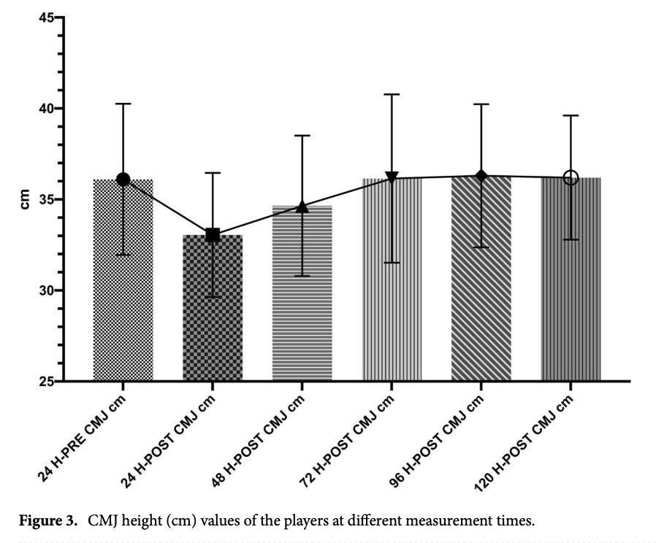
Rationale: Existing Research

Slide 6
Research questions, hypotheses and applied objectives
RQ1: Are CMJ JH and FT:CT measures responsive to EPL U-18 match play?
RQ2: Do players achieve neuromuscular recovery by 72 hours post-match?
H₁: Match play will induce changes to CMJ JH and FT:CT measures.
H₂: Match induced changes to CMJ JH and FT:CT measures will necessitate 48 to 72 hours to normalise.
APPLIED OBJECTIVES:
Refine the player fatigue monitoring process.
Simplify the practitioner decision making matrix.
Mitigate player injury risk.

Slide 7
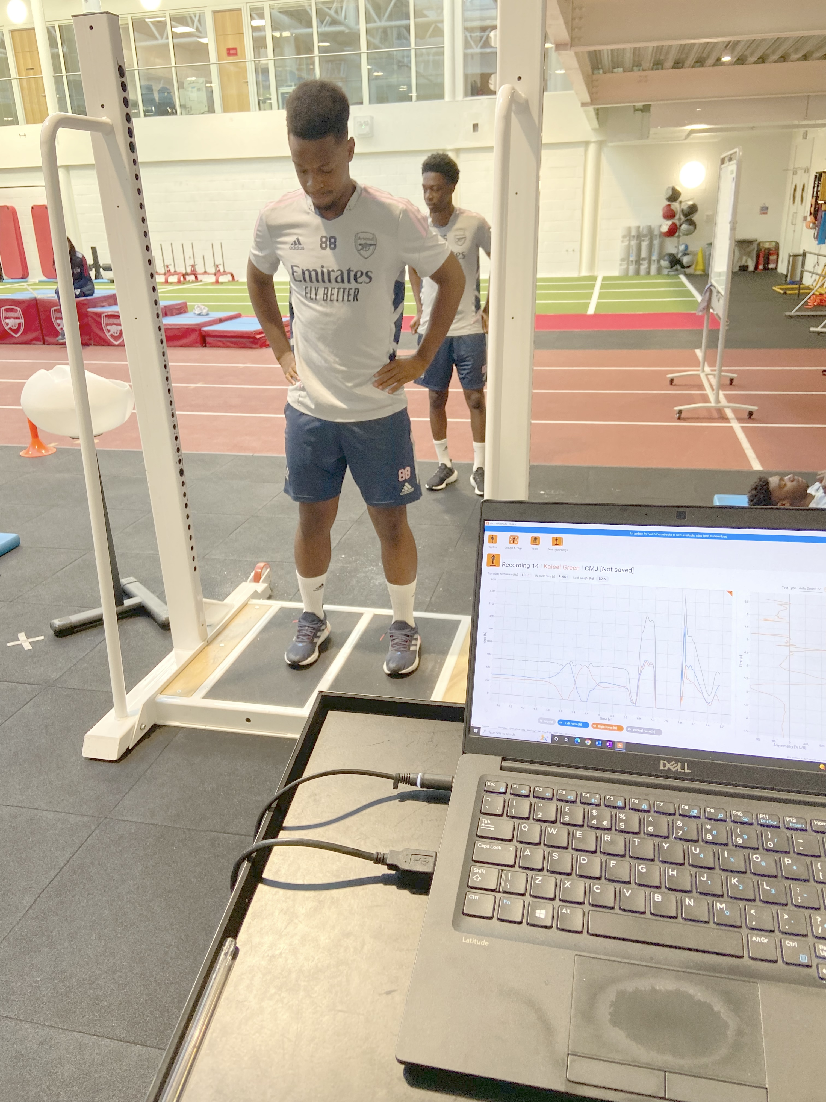
Methodology
Participant and Parental Consent / Assent.
n = 18
U-18 EPL Players from one category 1 academy team
Standardised Warm Up
Three Maximal CMJ Efforts.
ForceDecks FD400 & Proprietary Software.
CMJ JH, CMJ FT: CT extracted.
Five Time Points (MD-1, MD-PRE, MD-POST, MD+2 and MD+3)
8 Competitive League Home Games
Games evenly distributed across one competitive season.

Slide 8
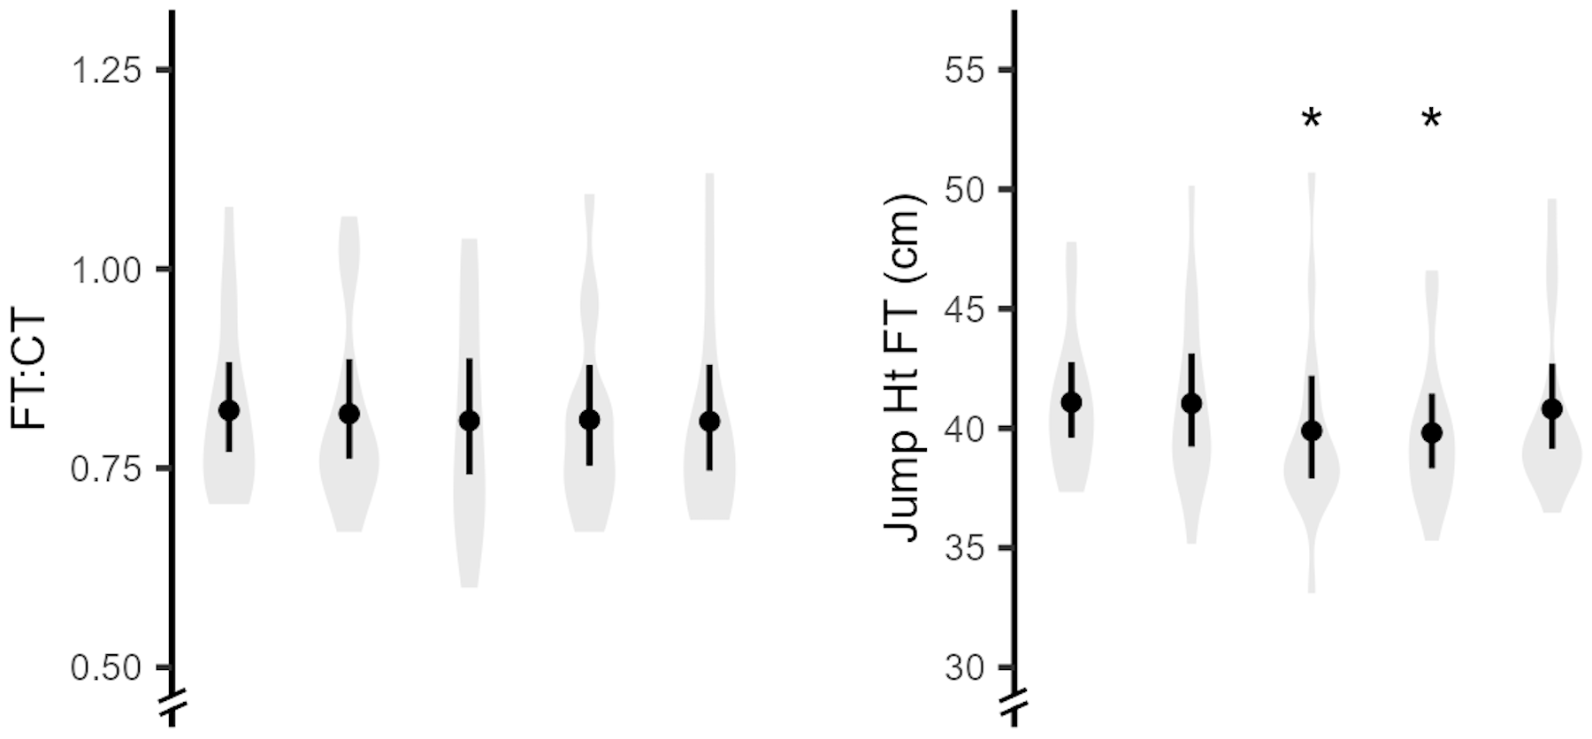
results
CMJ JH (FT): ↓ MD-1 to MD-POST (d = 0.33, small, p = 0.031) AND MD+2 (d = 0.35, small, p = 0.23). Returned to MD-1 at MD+3.
CMJ FT:CT: Small NSS ↓ (d = 0.22, p = 0.142) MD-1 to MD-POST.

Slide 9
conclusions
CMJ JH more sensitive to match play than CMJ FT: CT measures.
Contrasts the findings of Cormack et al (2008) ⁴ and challenges current NMF monitoring practices in academy football.
Differences related to ↑ movement variability in academy vs professional players?
Maybe… BUT JH and FT: CT measures both had excellent absolute and relative test re-test reliability in this cohort.
Greater efficacy of jump performance and not strategy measures for signalling NMF in academy football players?
Match induced changes to neuromuscular performance normalised by MD+3: (when players typically return to normal training).
Returning to normal training on MD+2 might increase injury risk based on time course of neuromuscular recovery.
Note: Individual responses warrants individualised player monitoring.

Slide 10
references
Reynolds J, Connor M, Jamil M, Beato M. Quantifying and Comparing the Match Demands of U18, U23, and 1ST Team English Professional Soccer Players. Front Physiol. 2021;12:706451.
Bittencourt NFN, Meeuwisse WH, Mendonca LD, Nettel-Aguirre A, Ocarino JM, Fonseca ST. Complex systems approach for sports injuries: moving from risk factor identification to injury pattern recognition-narrative review and new concept. Br J Sports Med. 2016;50(21):1309-1314.
Materne O, Chamari K, Farooq A, et al. Injury incidence and burden in a youth elite football academy: a four-season prospective study of 551 players aged from under 9 to under 19 years. Br J Sports Med. 2021;55(9):493-500.
Cormack SJ, Newton RU, McGuigan MR. Neuromuscular and endocrine responses of elite players to an Australian rules football match. Int J Sports Physiol Perform. 2008;3(3):359-374.
Akyildiz Z, Ocak Y, Clemente FM, Birgonul Y, Gunay M, Nobari H. Monitoring the post-match neuromuscular fatigue of young Turkish football players. Sci Rep. 2022;12(1):13835.
Deely C, Tallent J, Bennett R, et al. Etiology and Recovery of Neuromuscular Function Following Academy Soccer Training. Front Physiol. 2022;13:911009.

